Slide 1
Zanzibar update Center of Excellence for Central Bank Digital Currencies
Nicholas Drury
Director – Center of Excellence for CBDCs
26 October 2022
Notes:
Hello everyone. My name is Nick Drury. I'm the Director of the newly-formed Center of Excellence for CBDCs in Singapore, and will direct the growth of the CoE and oversee the exploration of opportunities for CBDCs to enable Mojaloop open source software to advance universal financial inclusion, and especially across the Asia region.

Slide 2

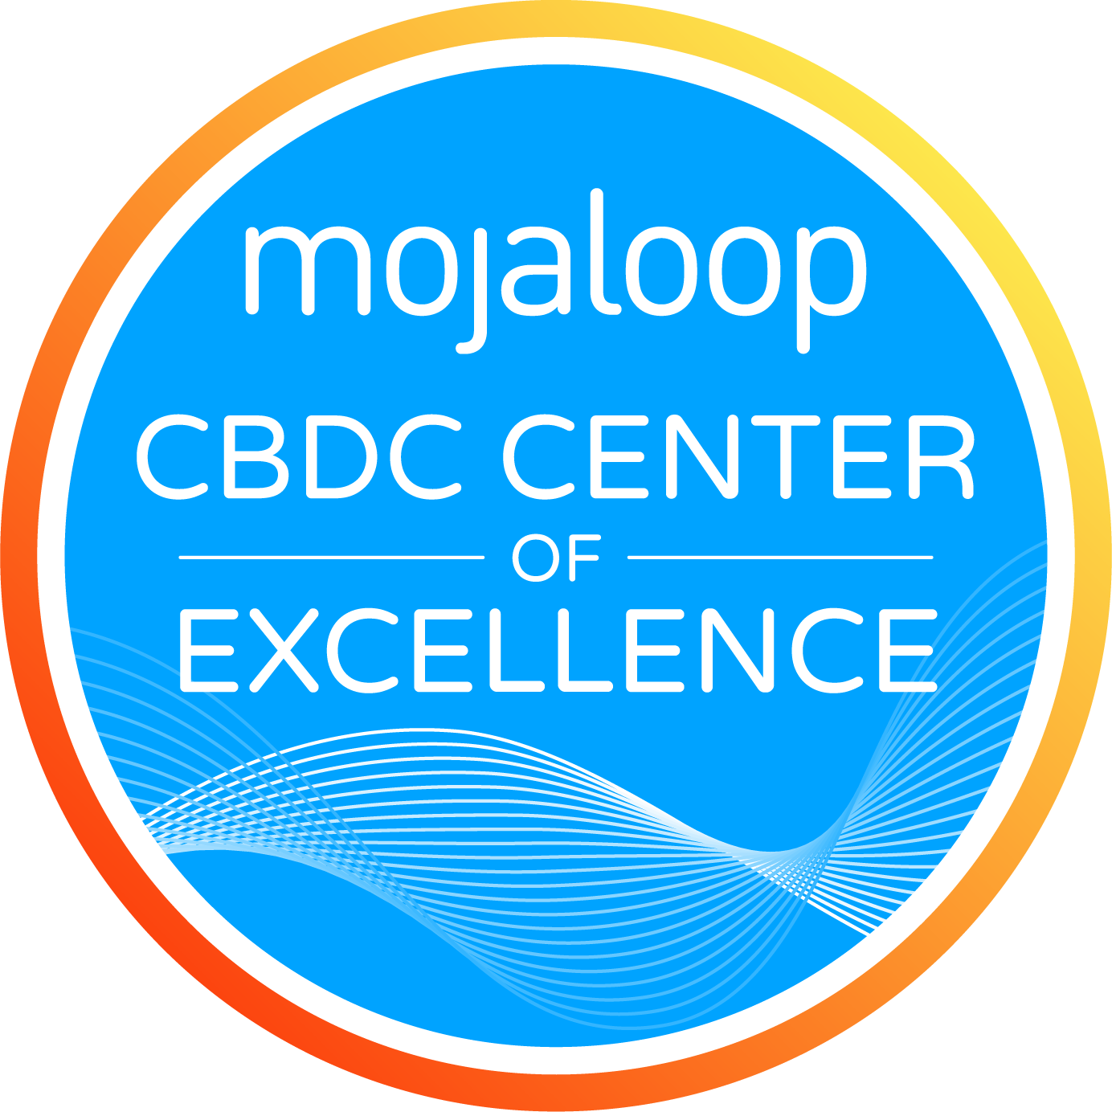


What could a CBDC be in practice?
Universal Financial Inclusion
Designing
Implementing
Operating
Working groups
Pilots
Hackathons
CDBD toolkits
Much more over time…
Notes:
On 20th June 2022, Mojaloop Foundation announced the launch of the Mojaloop Center of Excellence for CBDCs, as a significant milestone in fulfilling the organization’s promise of advancing financial inclusion in emerging markets – this time in Asia.
The new CoE will accelerate the broader adoption of inclusive, affordable, domestic and cross-border payment platforms that benefit the populations of entire emerging markets. The formation of the Mojaloop CBDC CoE working group comprises appointees from Mojaloop Foundation members, including BMGF, Coil, Google, ModusBox, MAS, Red Compass Labs, Ripple and Sybrin.

Slide 3
What have we been doing?
Major objectives
Forming working group - support for both a technology and business forum
Identifying priority projects
Tracking project KPIs
Hired
Director of Engineering
Hiring
Community manager – near closing
Operations manager – near closing

Slide 4
What’s next?
Singapore FinTech Festival 2-4th November 2022
At least four separate speaking slots for Mojaloop confirmed
CoE Working group to start in December
Domestic clearing with settlement in CBDCs
Domestic issuance and clearing of CBDCs
Cross-border payments pilot
Workshops
Hackathons
CBDC toolkit
Complete immediate hiring needs

Slide 5
Thank You!
https://mojaloop.io/
Nicholas Drury
Director – Center of Excellence for CBDCs
Ndrury@mojaloop.io

